Slide 1
Traffic-Light Control System
A project for hardware engineering lab
Team: GORGONZOLA
Muhammad Rohail Usman
Yigitcan Aydin
Syed Rafsan Ishtiaque

Slide 2
MOTIVATION
Conventional Traffic Light Controller.
4-Way Junction for Oversaturated Traffic Conditions.
Pedestrian Safety in Consideration.
Design Approach for a Real-World Hardware.

Slide 3
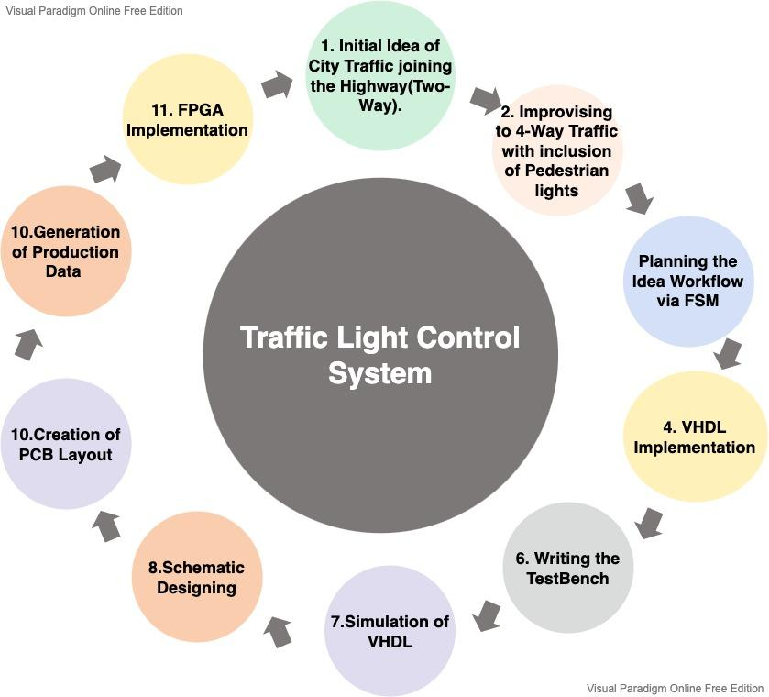
Concept Description

Slide 4
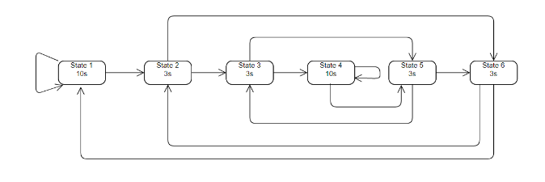
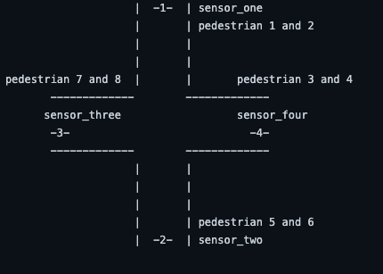
FINITE STATE MACHINE DIAGRAM

Slide 5
VHDL SIMULATION WITH MODELSIM

Slide 6
PCB DESIGN
Conceptual model:
Sensors to detect vehicles/ pedestrians
Switches were used instead of sensors
Complexity and cost of introducing sensors
Limitation of time
Future development: Sensors implementation

Slide 7
Components
1 FPGA: Intel / Altera EP4CE22E22C8N
12 GREEN LED-GREEN0603
12 RED LED-RED0603
4 YELLOW LED-YELLOW0603
1 OSCILLATOR, Device: OSCILLATORSMD-5X3
4 MOMENTARY-SWITCH, Device: MOMENTARY-SWITCH-SPST-SMD-4.5MM
32 220 Ohm Resistor

Slide 8
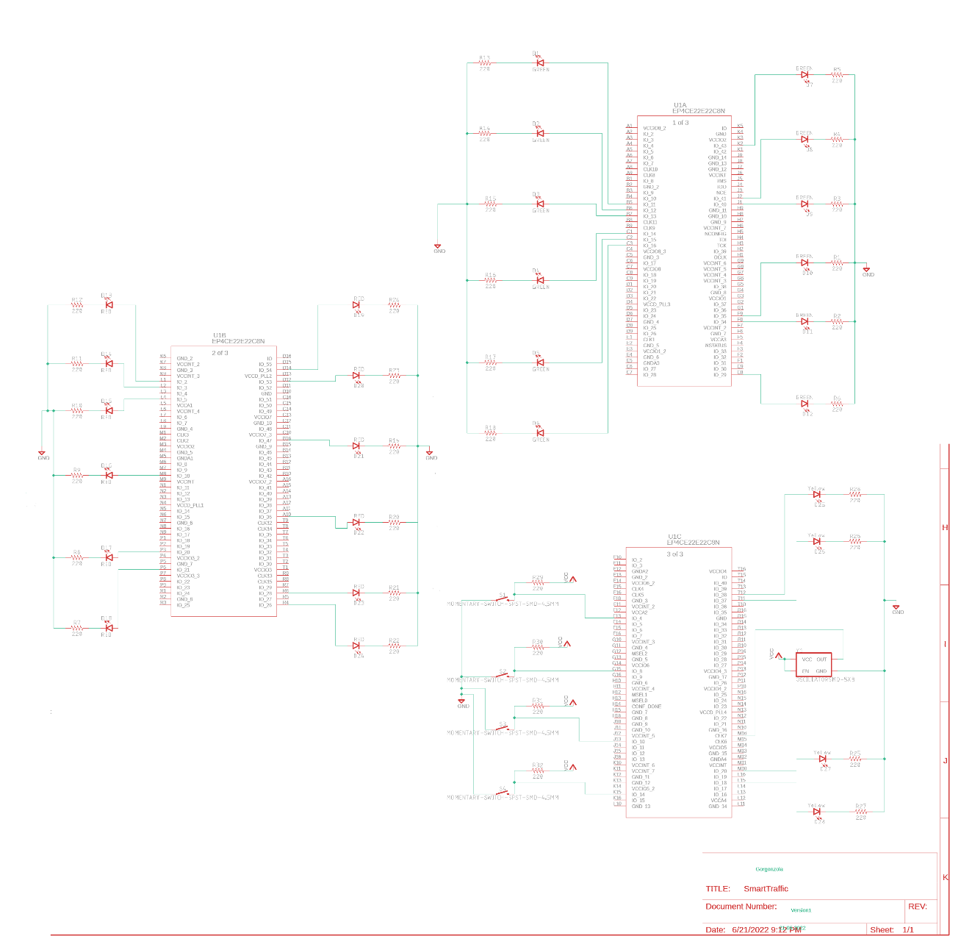
SCHEMATIC

Slide 9
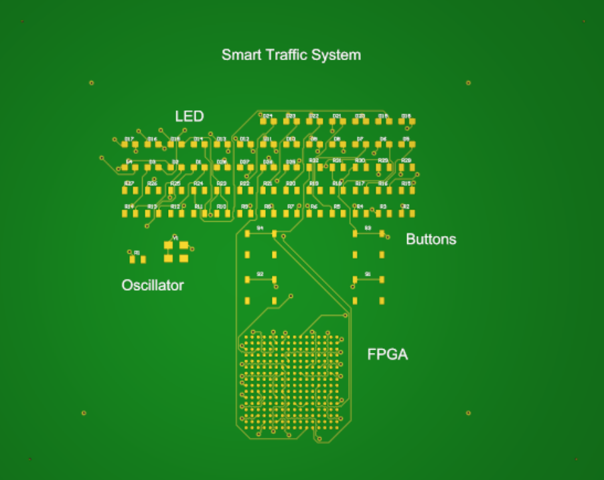

PCB Front view
PCB Rear view
Size: 100 × 80 millimeter

Slide 10
Cost:
FPGA: 75 €
Resistor: 32 × 0.25 € = 8 €
LED: 32 × 0.25 € = 8 €
Oscillator: 3 €
Switch: 4 × 1 € = 4 €
Total: 98 €

Slide 11
FPGA IMPLEMENTATION
The VHDL code developed during the project work was used
Software: ISE 14.7 Virtual Machine for Windows 10 software (Spartan3/ xc3s1000/ft256)
For reference, we have used the lecture slides

Slide 12
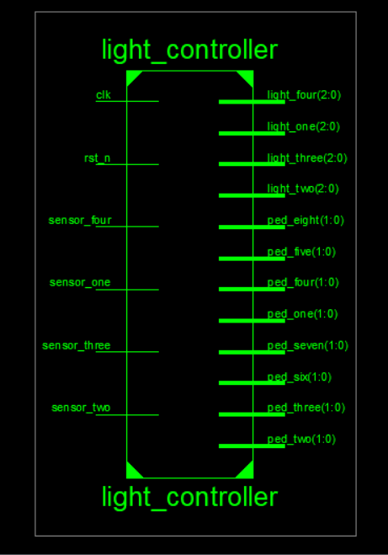
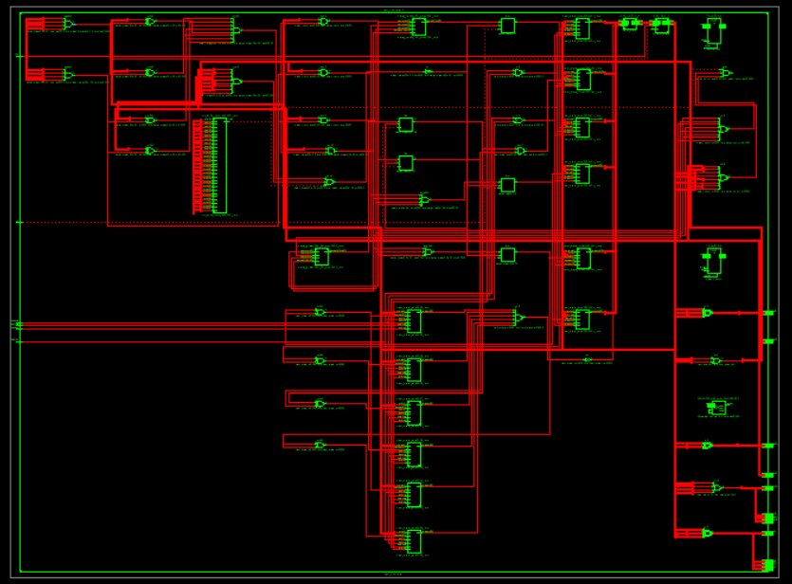
Technology Schematic
RTL

Slide 13
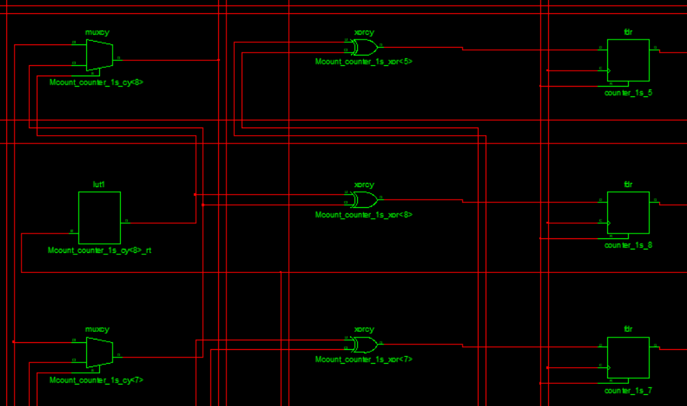
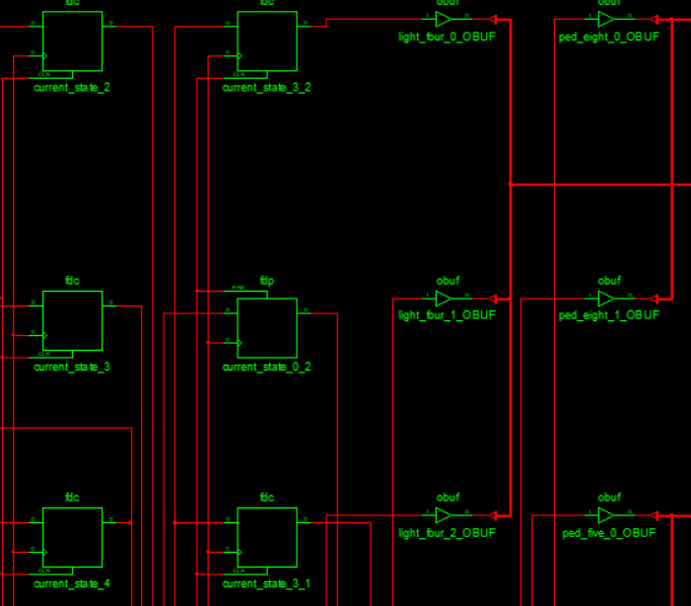
Technology Schematic FPGA component group 1
Technology Schematic FPGA component group 2

Slide 14
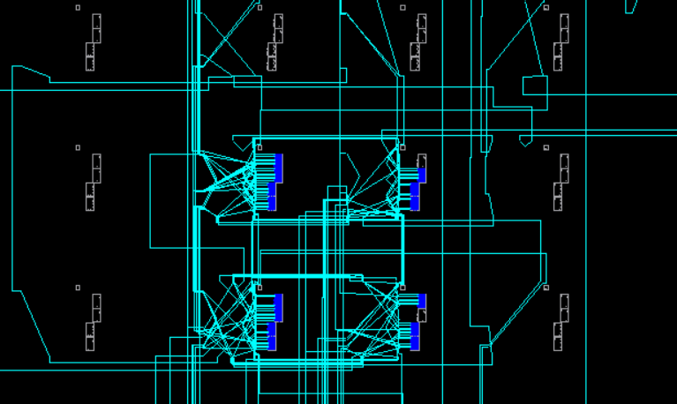
Routed Design for switches

Slide 15
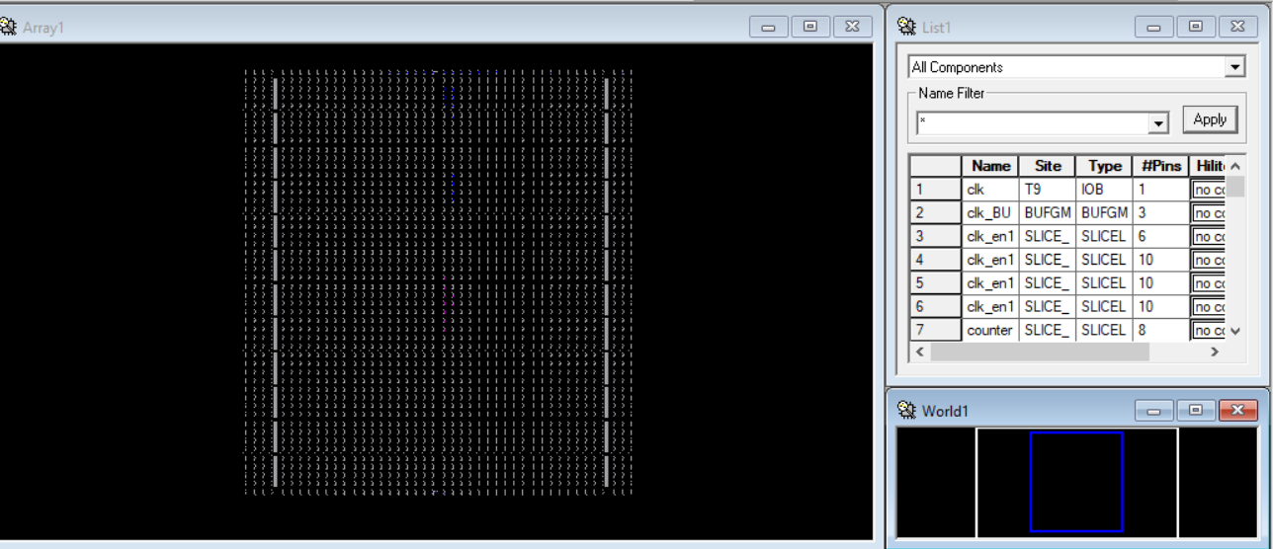
Routed Design with partial components
Constraints:
All pins are not mapped in ucf file, so the final bitstream file is not available
Partial UCF file with limited components is generated (located: Github repository)

Slide 16
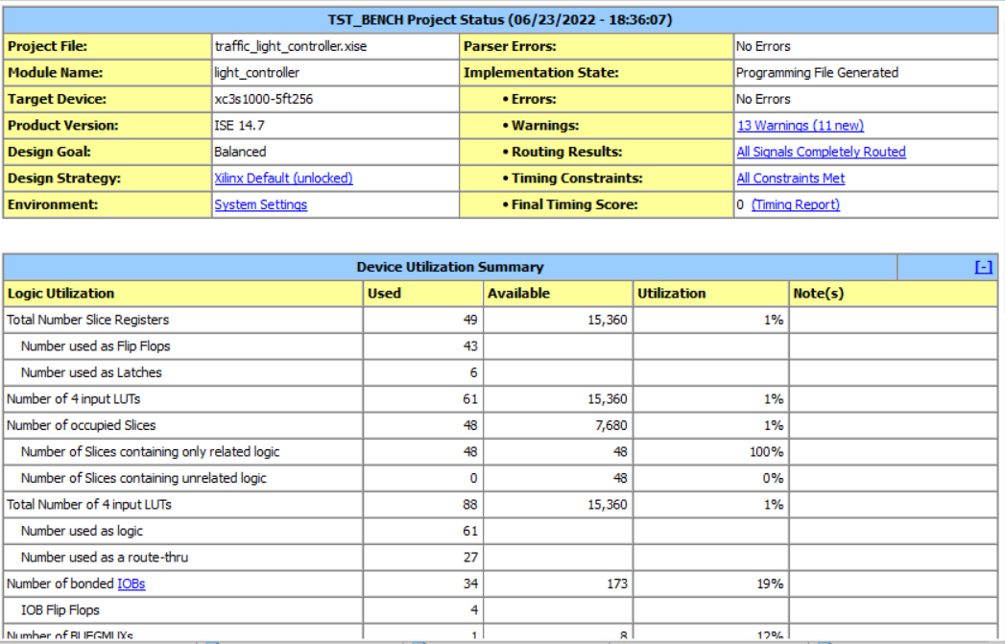
Design summary (Partial)

Slide 17
THANK YOU !
FOR YOUR ATTENTION !

